Slide 1
prediction of chronic kidney disease using machine learning

Slide 2
Team Members
Pavan Sundar Reddy G
SivaRaj Kumar P
Avula Ajay Kumar
B-Tech – Computer Science Engineering
2nd Year
SRMIST Ramapuram
B-Tech – Electrical & Electronics Engineering
3rd Year
Narasaraopeta Engineering College
B-Tech – Computer Science Engineering
3rd Year
Dr.M.G.R Educational & Research Institute

Slide 3
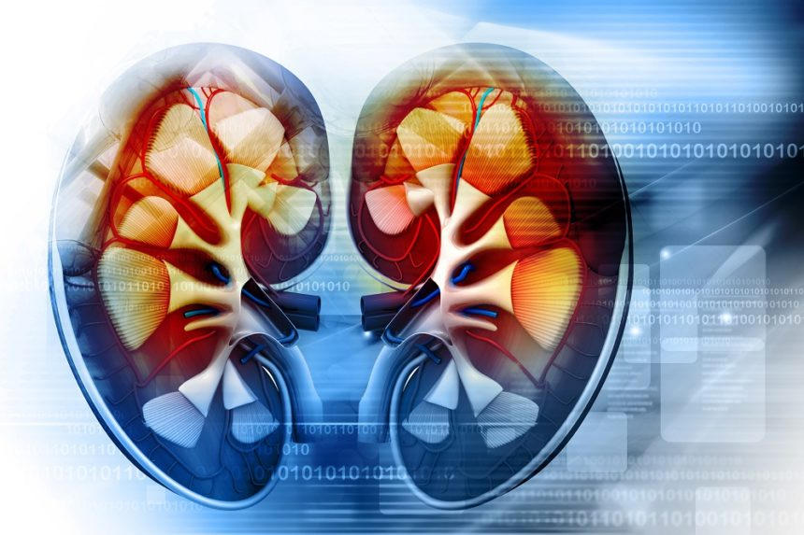
The term “chronic kidney disease” means lasting damage to the kidneys that can get worse over time. If the damage is very bad, your kidneys may stop working. This is called kidney failure. If your kidneys fail, you will need dialysis or a kidney transplant in order to live.

Slide 4
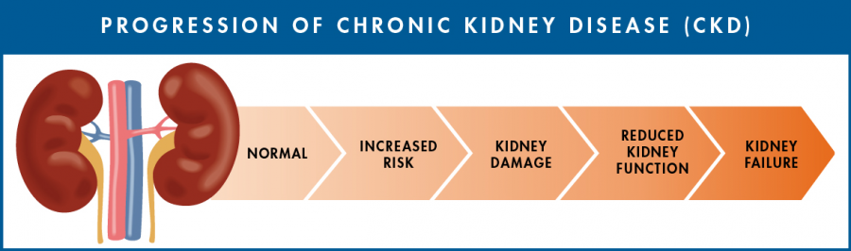
Progression of Chronic kidney Disease :-

Slide 5
Abstract :-
In this project, an attempt is made to develop a model evaluating personal data characteristics measured on a particular set of people. From the modeled data, we performed classification identifying whether or not each person is likely to have chronic kidney disease ("CKD"). In our model, we are all set to increase accuracy of the code using some algorithms which you see in next slides.

Slide 6
Objective :-
The main objective of this model is to predict whether he/she effected from ckd or not using different algorithms
Target of this model is to maintain moderate accuracy.
All we know that , CKD is an deadly disease but it can be curable by Kindey transplant.
Machine learning can help to identify risk of CKD at early stage.

Slide 7
Related works :-
Jignesh Mehta, analytics in machine learning, he used data visualization tools in Oracle analytics cloud without writing any code in R or python which is very complex to understand as well as very difficult to predict.
Link :- https://blogs.oracle.com/author/jignesh-mehta
Lars Boehm, IBM Associate partner, GBS watson health consulting leader, CH, He used Data Science for Predicting Diabetes-Related Chronic Kidney Disease with Real-World Data.
Link :- https://www.ibm.com/blogs/think/author/larsboehm/

Slide 8
Limitations:- :-
Ethical, legal and social issues.
Data ownership issues.
Heterogeneous medical complex physician’s interpretation with poor mathematical classification.
Privacy and security related to human data
It involves privacy issues and security issues and
Misuse or incorrect information.

Slide 9
Proposed system :-
In related work slide, we took 2 previous done dataset which are related to CKD prediction but with different platforms were used. Here, we are exploring machine learning algorithm for survival prediction of a human using CKD data. The system or model we used here is perform totally of some algorithms namely, SVM , Decision tree and Logistic regression.

Slide 10
System Architecture:- :-
Dataset :-
Collect the dataset.
Pre-process the dataset.
Assigning values to nominal data features.
Selected features are used for prediction
Find out the Accuracy.

Slide 11
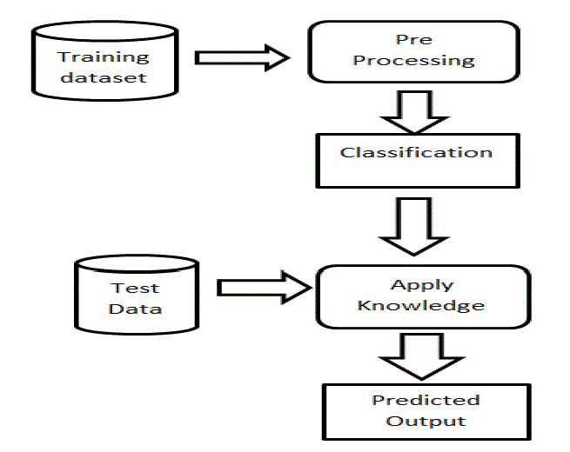
List of modules :-

Slide 12
Dataset Training:-
In Dataset, it consists of 400 patients data with 25 features.
We got this dataset from UCI Repository.
In features, 14 nominal and 11 numerical datatypes are present.
Pre- processing the data is mandatory because dataset had empty values

Slide 13
Pre- Processing :-
In this module, we replaced the numerical empty value features by using average of it.
And for Nominal features, firstly we replaced with 0’s & 1’s for deducing the complexity of algorithm.
Classification :-
We classified or selected some of features for prediction.
Some of classifiers are used here.

Slide 14
Testing The Dataset :-
For testing , we have used Logistic Regression algorithm.
For getting desired accuracy, we used naïve bayes algorithm.
Lastly we used KNN Classifier, Its purpose is to use a database in which the data points are separated into several classes to predict the classification of a new sample point.

Slide 15
Machine Learning Model :-
For Developing ML model, we used SVM in GUI .
We selected 4 features for predicting whether the person is having CKD or not.
Even though GUIs takes up much larger amount of space than other interfaces but its east to use and modify.

Slide 16
Results:
Accuracy of Prediction :-
Logistic Regression : 0.952(approx)
Naïve Bayes : 0.866(approx)

Slide 17
Conclusion
By using this model , we can able to predict whether the person is having CKD or not.
This is based on the features of the patient like RC, WC, BGR etc.
By predicting this we can say that the person is effected or not. If he/she is effected we can give some advice for further proceedings.

Slide 18


